Slide 1
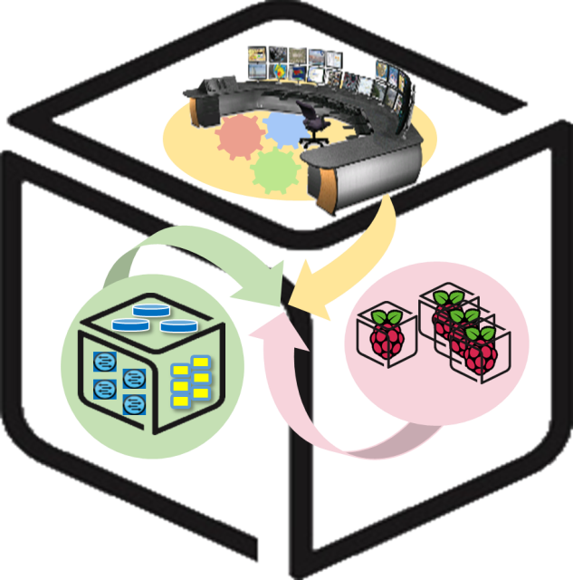
SmartX Labs for Computer Systems
Tower Lab
(2018, Spring)
NetCS Lab

Slide 2
History and Contributor of Tower Lab (2018 Spring)
Version | Updated Date | Updated Contents | Contributor
- | 2016/04 | (구) Playground Lab 최종본 작성 | 김 병 돈
v1.0 | 2016/05 | Build Lab 초안 작성 (Outline 및 Control Tower 추가) | 김 승 룡
v1.1 | 2016/05 | 검수 및 제안 사항 반영 (apt-get source 변경 내용 외) | 김 승 룡 김 진 우
v1.2 | 2016/05 | NUC에 대한 모니터링 추가 순서 변경에 따른 내용 변경 | 김 승 룡
v1.3 | 2016/05 | Lab 명칭 변경 (Build -> Tower) Hypervisor 관련 오류 수정 | 김 승 룡
v2.1 | 2017/05 | Merged with InterConnect & Tower Lab | 김 승 룡
v2.2 | 2018/01 | InfluxDB 버전 업데이트 스크립트 변경 | 이 승 형
V3.0 | 2018/05 | Lab 분할 및 소프트웨어 업데이트에 따른 내용 수정 | 김 승 룡

Slide 3
Goals
Understanding Concepts
InterConnect, Tower
MSA(Micro Service Architecture)
TSDB(Time Series Database)
Visibility & Visualization
Visualization of Resource Visibility
Monitor and Control

Slide 4
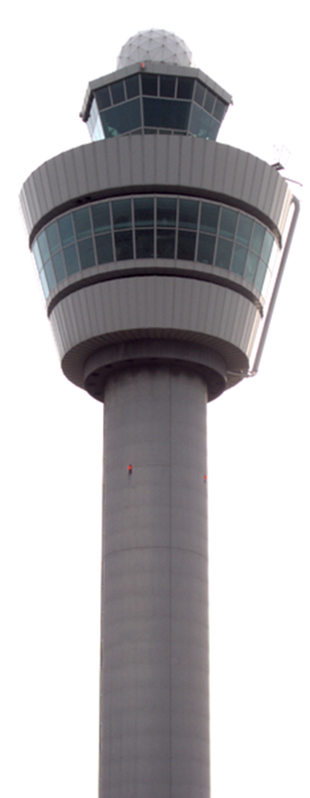
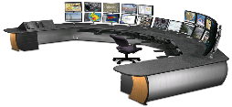











Concept: InterConnect Lab
You
Kafka broker cluster
Hypriot OS
Ubuntu Linux
Raspberry Pi
NUC
Notes:
IoT-FastData-Cloud에 기반한 Container 대응 SmartX-mini

Slide 5
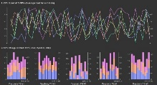



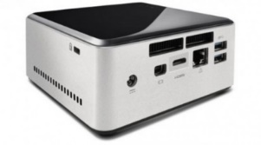
Concept: Tower Lab
Control Tower
Visibility
Center
(Container)
Orchestration
Center
(Container)
Provisioning
Center (Container)
Intelligence
Center (Container)
Base OS

Slide 6





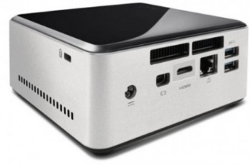


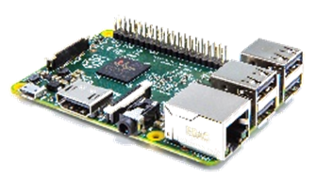



Relation of SmartX Lab
Control Tower
Orchestration
Center
(Container)
Provisioning
Center (Container)
Intelligence
Center (Container)
Visibility
Center
(Container)
Tower Lab
Base OS
Kafka broker cluster
Box Lab
VM
Tap1
br0
em1
InterConnect Lab
Hypriot OS

Slide 7
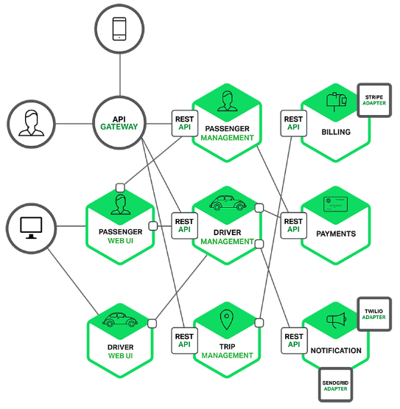
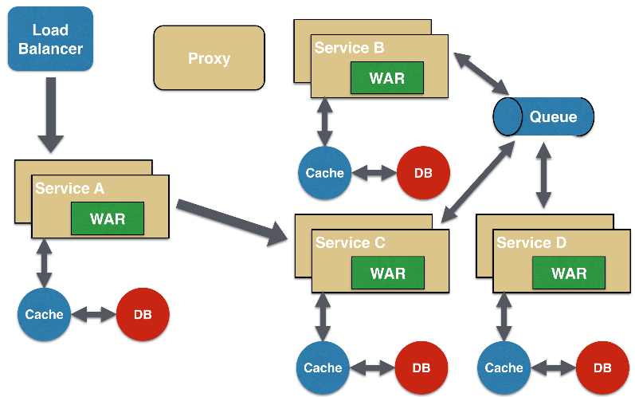
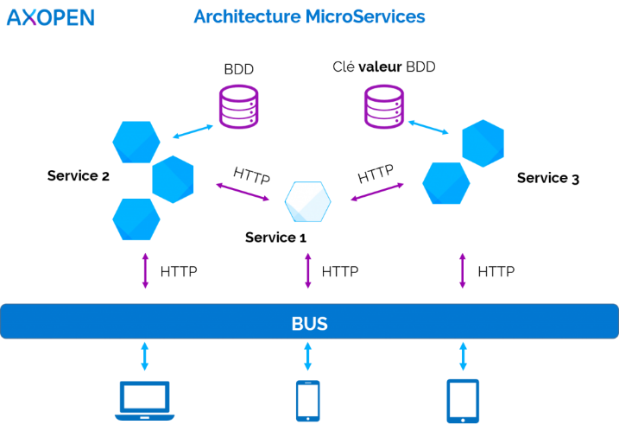
MSA(Micro Service Architecture)
Software development technique
Collection of loosely coupled services.
fine-grained services and lightweight protocols
Improves modularity
Makes the application easier
More resilient to architecture erosion

Slide 8
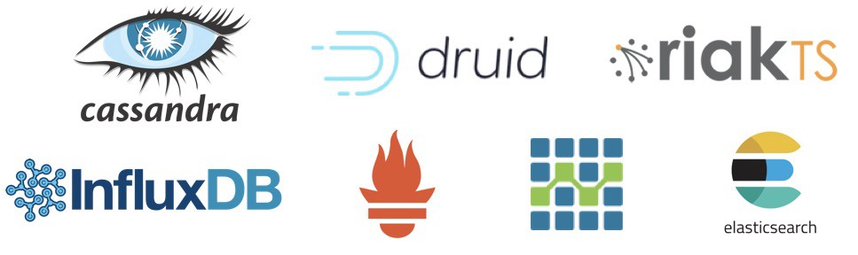
TSDB(Time Series Database)
Software system that is optimized for handling time series data, arrays of numbers indexed by time.
In some fields these time series are called profiles, curves, or traces.
A time series of stock prices might be called a price curve.
A time series of energy consumption might be called a load profile. A log of temperature values over time might be called a temperature trace.

Slide 9
Visualization of Resource Visibility

Slide 10
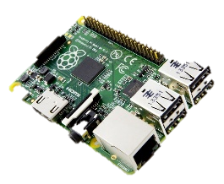

0. Finish InterConnect Lab
Check List
NUC
Zookeeper Container
Kafka Containers (3 Containers)
Consumer Container
Raspberry Pi
Flume Container
Are they working? If you can see logs of resource status on console consumer, go ahead!

Slide 11
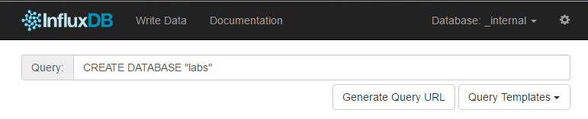
1. Run InfluxDB Container on NUC
Run InfluxDB Container
$ cd SmartX-mini/ubuntu-influx
$ docker run -p 8083:8083 -p 8086:8086 -v $PWD:/var/lib/influxdb -e INFLUXDB_ADMIN_ENABLED=true --name influx influxdb:1.0
Connect Web UI
http://localhost:8083/
Create Database(Name: labs)
CREATE DATABSE “labs”

Slide 12
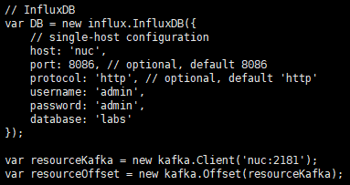
2. Insert Data from Kafka to InfluxDB
Modify hostname in source code ‘kafka_to_db.js’
$ cd SmartX-mini/ubuntu-kafkatodb
$ vi kafka_to_db.js
Build and run container
$ sudo docker build --tag kafkatodb .
$ sudo docker run -d --net=host --name kafkatodb kafkatodb

Slide 13
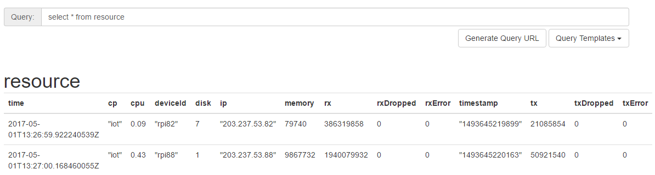
3. Check Data in InfluxDB
Then, we can check the data in DB
SELECT * FROM resource

Slide 14
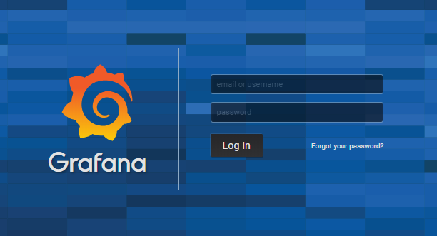
4. Run Grafana Container
Run InfluxDB Container
$ docker run -d --net=host --name grafana grafana/grafana
Connect Web UI
http://localhost:3000/
ID/PW = admin/admin

Slide 15
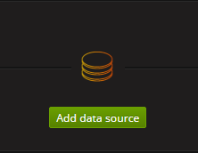
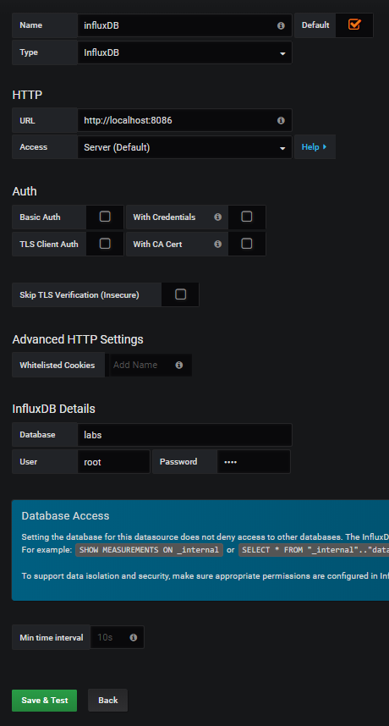
5. Configure Grafana Dashboard
Follow below sequences with written option values
root/root

Slide 16
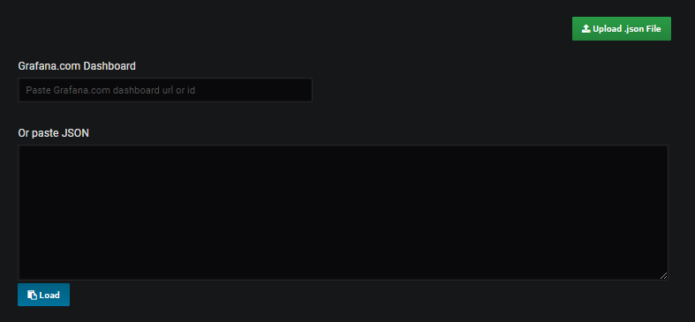
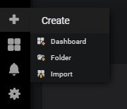
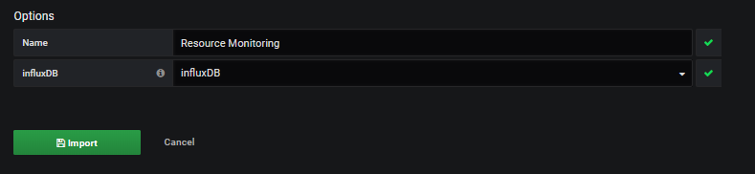
5. Configure Grafana Dashboard
Follow below sequences with written option values

Slide 17
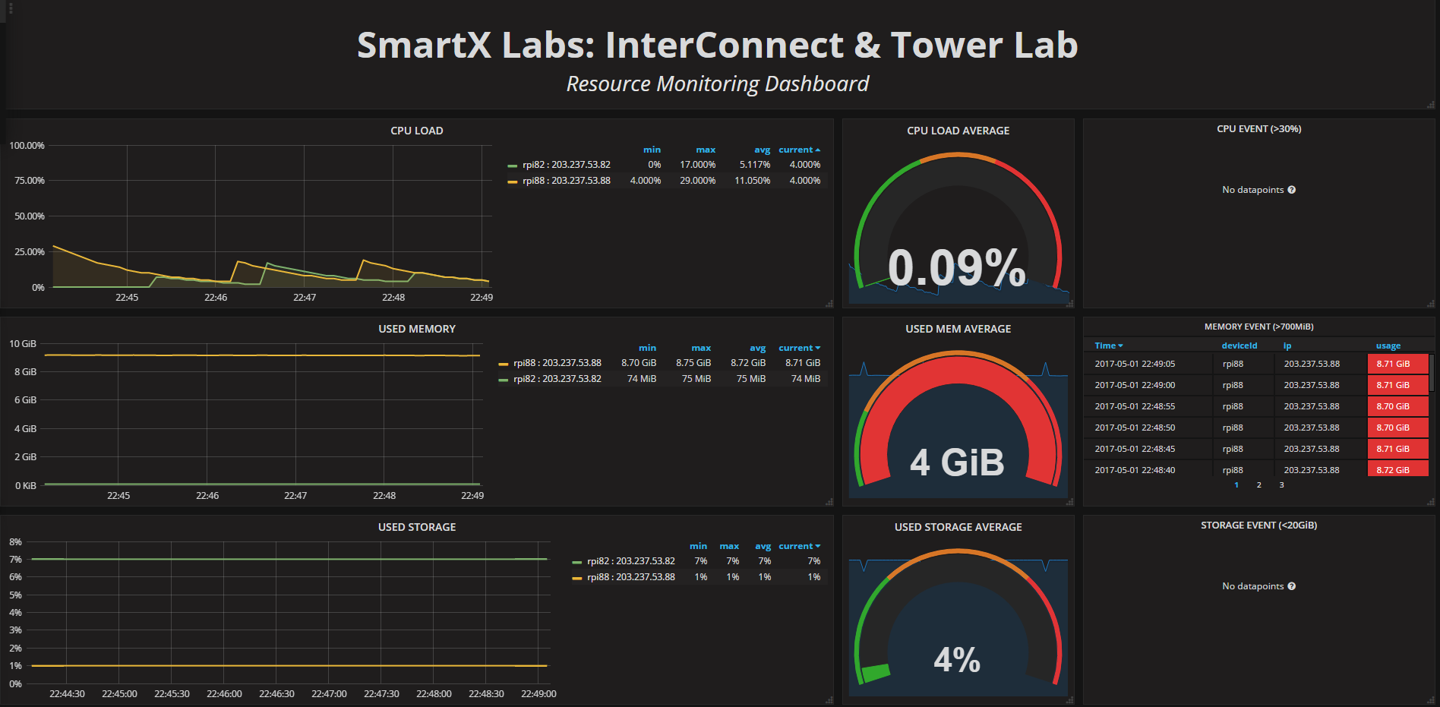
6. Check Dashboard
We can see the changes of values from database

Slide 18
7. Stress Test
Install and start a stress test tool
$ sudo apt-get install stress
$ stress -c 4 -t 60s
What happens on the dashboard?
Why?
How can we monitor metrics faster and more reliable?

Slide 19
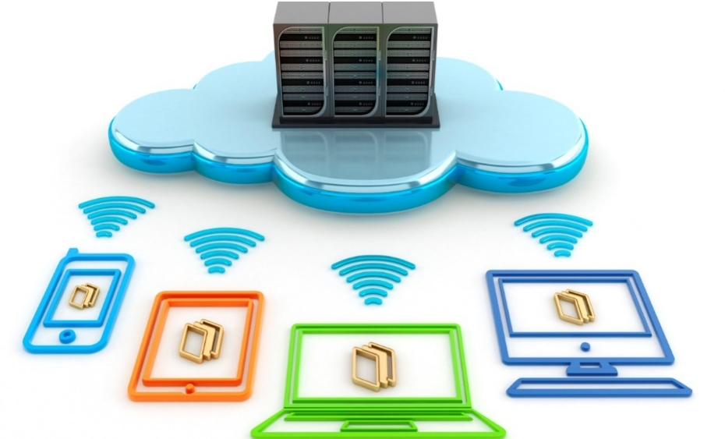
Thank You for
Your Attention
Any Questions?

Slide 20
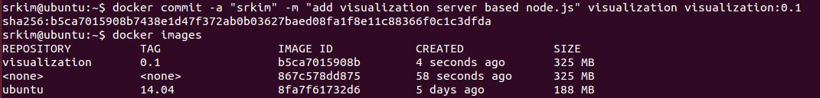
(참고) Container 변경사항 저장 및 재시작
Commit Container
컨테이너 내의 변경사항을 반영하여 새로운 컨테이너 이미지 작성
Ctrl+P+Q
docker commit -a “[username]” -m "add visualization server based node.js" visualization visualization:0.1
Restart Container
Stop했던 컨테이너를 Restart하면 이전 작업 내용을 유지한 채로 다시 컨테이너를 시작할 수 있다.
docker stop visualization
docker restart visualization

